Slide 1
NAVIGATION BRIEF
NN284x Navigation Project Assignments
NS Everett to Yokosuka, Japan
8-11DEC22
Notes:
Kat

Slide 2
TEAM MEMBERS
TEAM MEMBERS NAMES
Notes:
Kat

Slide 3
Mission
State your Commander’s Intent
Objectives: State your objectives for the transit
Notes:
Kat

Slide 4
SOE
Thursday, 8 Dec 22
1600 – Provide a breakdown of your expected schedule of events. Include important events, such as setting a Sea and Anchor Detail, UNREP detail, switching time zones, etc.
Notes:
Christian
add underway SOE w/ info on when and where training is occuring
also add underway SOE for transit back to USNA

Slide 5
SOE Con.
Saturday, 10 Dec 22

Slide 6
SHIP CHARACTERISTICS

Slide 7
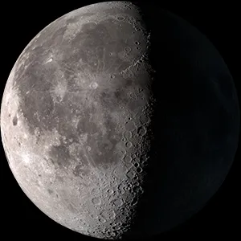
ASTRONOMICAL DATA
Event | 8 DEC | 9 DEC
Moonrise | 1657 | 1746
Sunrise | 0712 | 0713
Moonset | 0747 | 0844
Sunset | 1643 | 1643
Waning Gibbous
Provide details on the astronomical data when you leave port!
Notes:
Lewie
https://www.timeanddate.com/astronomy/usa/annapolis
Chronological order

Slide 8
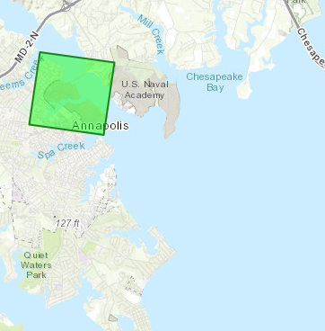
WEATHER-OUTBOUND PORT
08 DEC 22- ANNAPOLIS (1900 departure)
As of 071245RDEC22
Skies: Cloudy
Forecast: Mostly Cloudy
Temperature:53F/39F
Water Temperature: 48F
Humidity: 78%
Winds: 7 kt N
Precipitation: 7% chance of rain
Cloud Cover: 72%
Sea State: 1-2 ft
Visability: 10 NM
Notes:
AJ
Add avg water temperature for the week

Slide 9
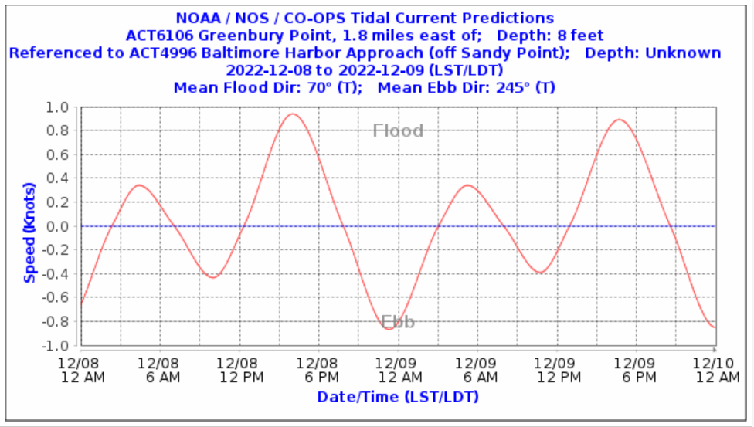
CURRENT-Port of Departure
0.6 kt Flood @ 1900
Notes:
Lewie
https://tidesandcurrents.noaa.gov/noaacurrents/Predictions?id=ACT6106_1

Slide 10
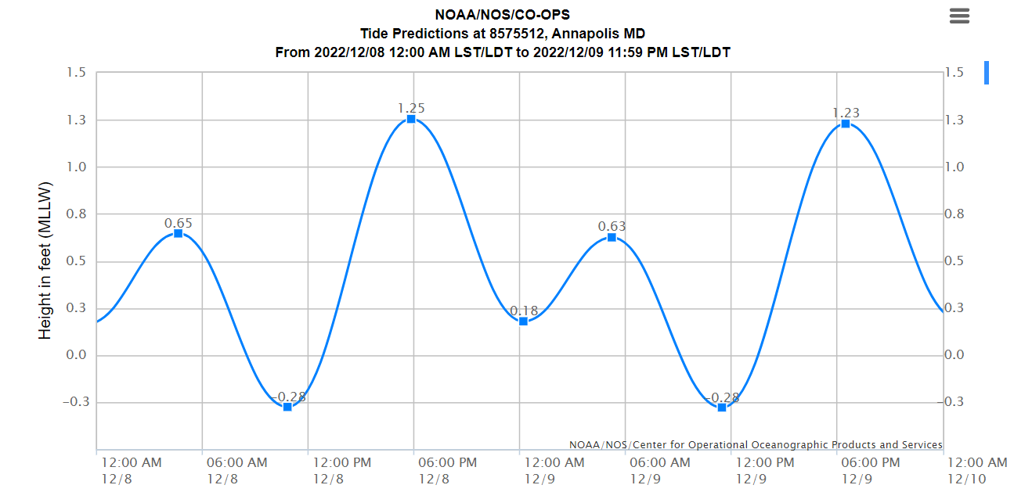
TIDE – Port of Departure
1.23ft Above MLLW @ 1900
Notes:
AJ
https://tidesandcurrents.noaa.gov/noaatidepredictions.html?id=8575512

Slide 11
TRACK DATA OUTBOUND Port
Leg | Course (°) | Speed (kts) | Dist (yds)
1 | 126T | 6 | 1960
2 | 153T | 8 | 1700
3 | 126T | 8 | 2660
TURNS BASED ON STANDARD RUDDER AT 8 KNOTS
Notes:
AJ

Slide 12
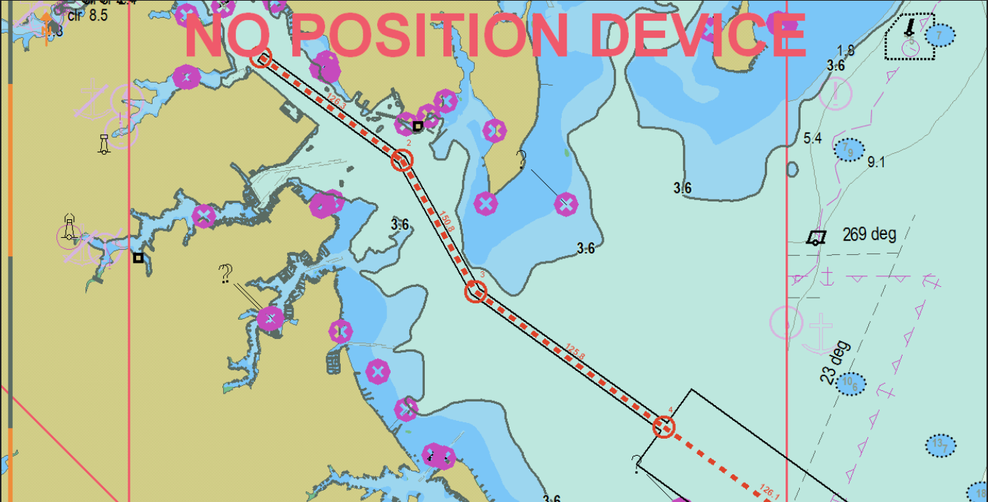
OUTBOUND LEGS 1 - 3
Notes:
AJ

Slide 13
OUTBOUND LEGS 1 - 3
Notes:
AJ

Slide 14
OUTBOUND LEGS 1 - 3
Notes:
AJ

Slide 15
TRANSIT INFORMATION
Designated Shoal Water:
36 FT (11m) BOLD BLACK soundings on DNCs Deepest Projection
Transit information:
LOOK INTO COAST PILOTS AND FIND SOME INFORMATION ABOUT THE DEPARTURE PORT THAT IS RELEVANT.
Average Depth of Water for Transit:
Average charted depth: 38-50 FT
Emergency Anchorages:
Anchor using 5x the water depth for shots used.
Bottom type: Sand and Mud
15 fathoms in each shot
1 shot = 90 FT
From Courage…Life

Slide 16
TRANSOCEANIC ROUTE
TAKE VMS SCREENSHOTS OF YOUR TRANSOCEANIC VOYAGE AND PRESENT THEM
Notes:
AJ

Slide 17
TRANSOCEANIC ROUTE
TAKE VMS SCREENSHOTS OF YOUR TRANSOCEANIC VOYAGE AND PRESENT THEM
Notes:
AJ

Slide 18
TRACK DATA INBOUND Port
Leg | Course (°) | Speed (kts) | Dist (yds)
58 | 070T | 10 | 2400
59 | 054T | 10 | 5600
Final | 094T | 10 | 1000
TURNS BASED ON STANDARD RUDDER AT 10 KNOTS
Notes:
AJ

Slide 19
INBOUND LEGS 1 - 3
Notes:
AJ

Slide 20
INBOUND LEGS 1 - 3
Notes:
AJ

Slide 21
INBOUND LEGS 1 - 3
Notes:
AJ

Slide 22
ANCHORAGE POINT
Notes:
AJ

Slide 23
ANCHORAGE TRACK DATA
HEAD BEARING | DROP BEARING | DROP RANGE | DEPTH OF THE WATER
VA-346°T | VB-346°T | RA-3400 YARDS | 25 FT
BOTTOM TYPE-SAND AND MUD
REQUIRED LENGTH OF CHAIN FOR 5-7X THE WATER DEPTH-125FT TO 175FT
NUMBER OF SHOTS REQUIRED-2 SHOTS
Notes:
AJ

Slide 24
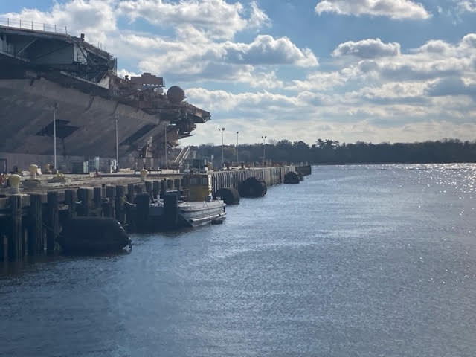
TRY TO PROVIDE PICTURES OF INBOUND PORT
Notes:
Lewie

Slide 25
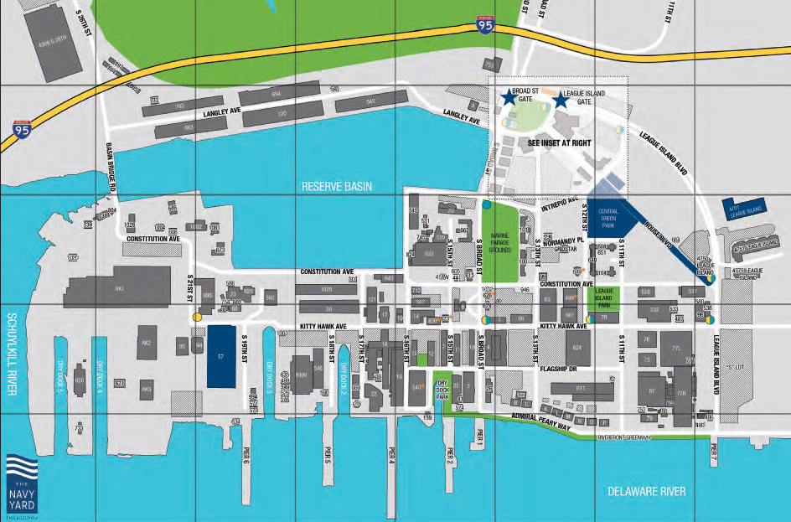
INBOUND PORT PICTURES
PIER 4
Notes:
Lewie

Slide 26
NAVIGATION DATA
SNC
12283 | LNM 38/22
Shoal water (blue) | 12ft
GPS Datum | WGS-84
DNC
REGION XX XX XX | CORRECTED THRU XX/XX
Shoal water (blue) | 12ft
GPS Datum | WGS-84
LIST BUOYAGE SYSTEM!
Notes:
Pat
World Geodetic System - 84

Slide 27
COMMUNICATIONS
Bridge-to-Bridge
Ch 12 | OUTBOUND HARBOR CONTROL
Ch 13 | LIST ALL APPLICABLE VHF CHANNELS NEEDED FOR VOYAGE
Ch 16
Ch 69
Ch 71/82a
Notes:
Pat

Slide 28
OPERATIONAL CONSIDERATIONS
Traffic:
Civilian Traffic - Pleasure Craft
MV Traffic
Potential Reduced Visibility
Force Protection: None
Visitors: None
Uniform: NWU/Coveralls
THINK ABOUT ALL APPLICABLE CONSIDERATIONS AS YOU LEAVE PORT AND PROCEED ON YOUR VOYAGE
Notes:
Pat
CGC SPAR 1200-1600 Baltimore → Annapolis

Slide 29
MATERIAL CONDITION
LIST WHAT CONDITION (I, II, III, IV) YOU WILL BE IN FOR THE DURATION OF THE TRANSIT AND STATE YOUR REASON/
Notes:
Pat
CGC SPAR 1200-1600 Baltimore → Annapolis

Slide 30
NAVIGATION EQUIPMENT
Fwd WSN-7 | UP | SPS 67 | UP
Aft WSN-7 | UP | SPS 73 | UP
Centerline Gyro | UP | SPA 25G Bridge | UP
Helm Gyro | UP | SPA 25G CIC | UP
Aft Steering Gyro | UP | VMS | UP
Fwd GVRC | UP | Fathometer | UP
Aft GVRC | UP | DFGMC | UP
DAGR (GPS) | UP | AIS | UP
ENL | UP | DEML | UP
SHIP’S WHISTLE | UP | FURUNO | UP
NOTES: NTR
From Courage…Life

Slide 31
ENGINEERING EQUIPMENT
1A HPU | UP | 2A HPU | UP
1B HPU | UP | 2B HPU | UP
EPCC | UP | 1A/2A LCU | UP
PACC | UP | 1B/2B LCU | UP
PORT SHAFT- NR2 SCU | UP | PORT RUDDER | UP
STBDSHAFT- NR1 SCU | UP | STBD RUDDER | UP
FWD CRP | UP | BRIDGE CONTROL UNIT | UP
AFT CRP | UP | AFT STEERING UNIT | UP
From Courage…Life

Slide 32
EMERGENCIES
Casualty | Procedure
Loss of Steering | Follow EOCC - Slow speed to bare steerageway, maneuver with engines, and man aft steering.
Loss of Propulsion | Follow EOCC - Maneuver towards safe water, anchor if needed, prepare for tow.
Loss of RADAR | Utilize visual or GPS fixes, maintain SA and call more people to bridge for lookouts.
Man Overboard | Sound 6 short blasts, begin Anderson turn, muster the crew, notify traffic in the area, hoist the Oscar flag, and call Annapolis Harbor Control to arrange for medical care.
Gyro Failure | Shift to backup Gyro, then shift to magnetic heading, utilize RADAR, and notify EM/ET to troubleshoot.
Loss of ECDIS | Shift to forward station. If INOP, shift to paper plot, slow, and immediately establish ship’s position.
Low Visibility | Station forward lookout, energize nav lights, sound signals IAW the Rules of the Road, slow to safe speed.
Loss of Comms | PriTac – Shift to BTB. BTB – Shift to handheld BTB. HH BTB – Shift to Cell/G-Chat.
Notes:
Pat

Slide 33
OPERATIONAL RISK ASSESSMENT
PROBABILITY
 | A | B | C | D
I | 1 | 1 | 2 | 3
II | 1 | 2 | 3 | 4
III | 2 | 3 | 4 | 5
IV | 3 | 4 | 5 | 5
SEVERITY
Mishap Probability
A Likely to occur
B Probably will occur in time
C May occur in time
D Unlikely to occur
Risk Assessment Code
1 – Critical
2 – Severe
3 – Moderate
4 – Serious
5 - Negligible
Hazard Severity
I May cause Death, Loss of Asset, or Grave Damage to National Interests
II May cause Severe Injury, Illness, Damage or Degradation of Assets
III May cause Minor Injury, Illness, Damage or Degradation of Assets
IV Hazards present a minimal Threat to Personnel or Assets
Notes:
Kat
33

Slide 34
OPERATIONAL RISK MANAGEMENT
Hazard | Contributing Factors | Initial RAC | Assumptions | Controls | Revised RAC
Grounding | Unmarked navigation hazards Unable to obtain an accurate fix Lack of situational awareness Narrow Transit (New point comfort shoal) Inexperience | I/C: 2-Severe | ECDIS DNC updated Charts accurate with NTM updates applied GPS and fathometer are operational | Utilize all methods of determining position Familiarize yourself with charts/tracks | II/C: 3-Moderate
Collision | Lack of communication between vessels Low visibility Loss of maneuverability Narrow Transit Inexperience Windy, Rainy departure from Annapolis | I/C: 2-Severe | All vessels will be in compliance with the Rules of the Road Watchstanders are paying attention | Use BTB early follow Navigation Rules Use RADAR Emergency maneuver to avoid collision | II/C: 3-Moderate
Notes:
34
Kat
Secure weather decks during high winds and sea state.

Slide 35
OPERATIONAL RISK MANAGEMENT
Identify Hazard | Contributing Factors | Initial RAC | Assumptions | Controls | Revised RAC
Personal Injury/ Man Overboard | Personnel not paying attention MOB Unintentional maneuver Heat (Heat casualties) | I/C: 2-Severe | Watchstanders are qualified Personnel pay attention to surroundings | Secure weather decks sunset-sunrise Everyone is a lookout Stay hydrated | II/C: 3-Moderate
Comms Failure | Improper use Not monitoring radios/flags | III/B: 3-Moderate | Lookouts will watch for flag signals CIC will work with Bridge to listen into nets and BTB | Bridge silence during radio transmission/ reception Utilize backup comms | III/C: 4-Serious
Notes:
Kat

Slide 36
OPERATIONAL RISK MANAGEMENT
Identify Hazard | Contributing Factors | Initial RAC | Assumptions | Controls | Revised RAC
Breakdown in Bridge Resource Management | Too many personnel on the bridge Watchstanders get distracted | II/B: 2-Severe | Only watchstanders and necessary personnel are on bridge | Minimize non-watchstanders on bridge Keep noise level at minimum Maintain good communications between watchstanders | II/C: 3-Moderate
Steering/ Propulsion Casualty | Failure over time Midshipmen not recognizing/vocalizing casualties | I/C: 2-Severe | PMS is maintained, equipment is operational prior to evolution | Conduct propulsion and steering checks prior to entering restricted waters Be prepared to tow Focus, pay attention and inform crew of engineering casualty | II/C: 3-Moderate
Notes:
Kat

Slide 37
OPERATIONAL RISK MANAGEMENT
Overall RAC: 3 (Moderate)
Identify hazards
Assess risk
Implement controls
Assess adjusted risk

Slide 38
Lessons Learned
APPLY ANY LESSONS YOU LEARNED FROM YOUR TIME ON THE YP LABS AND OTHER YP MOs/LANTPATs YOU MAY HAVE ATTENDED.

Slide 39

QUESTIONS?

